Slide 1
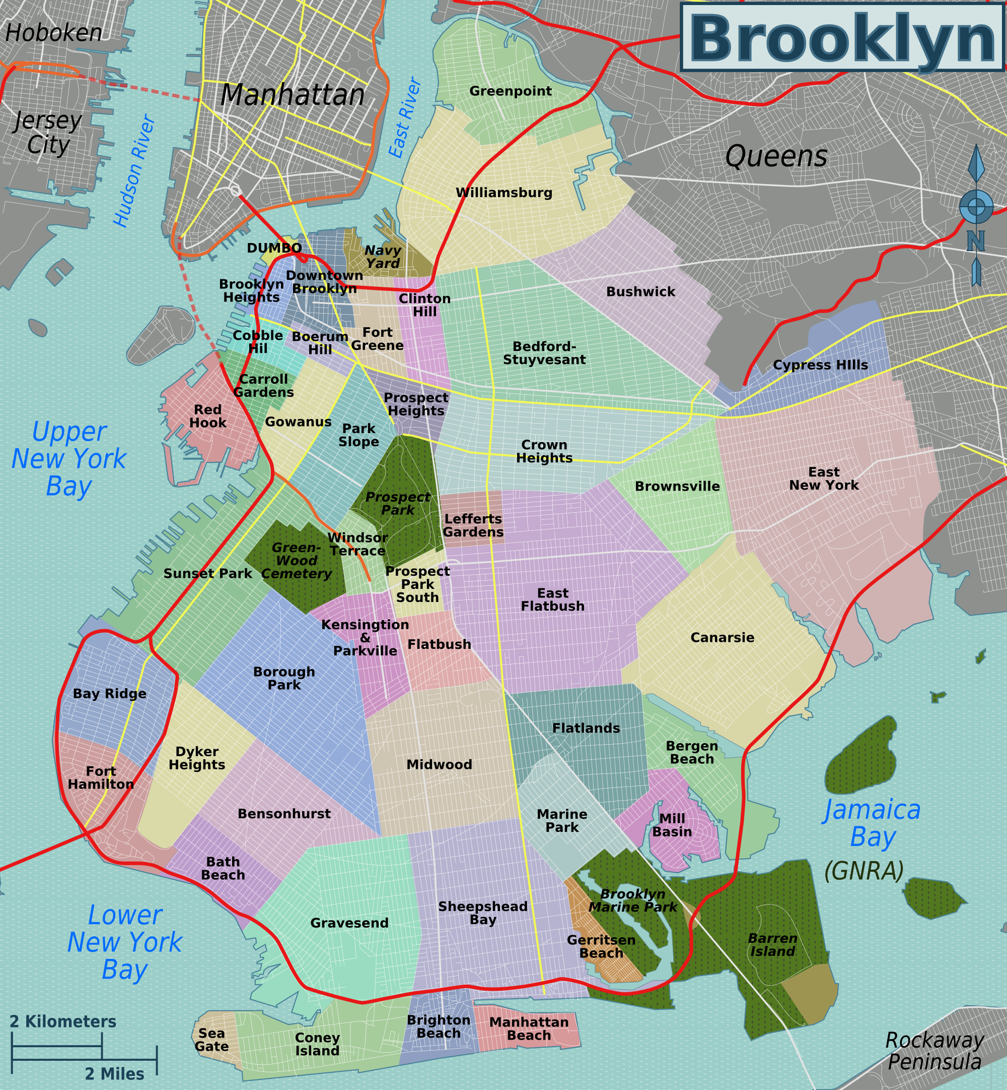
Capstone Project
Opening Italian Cuisine Business in Brooklyn
Afrioni Roma Rio

Slide 2
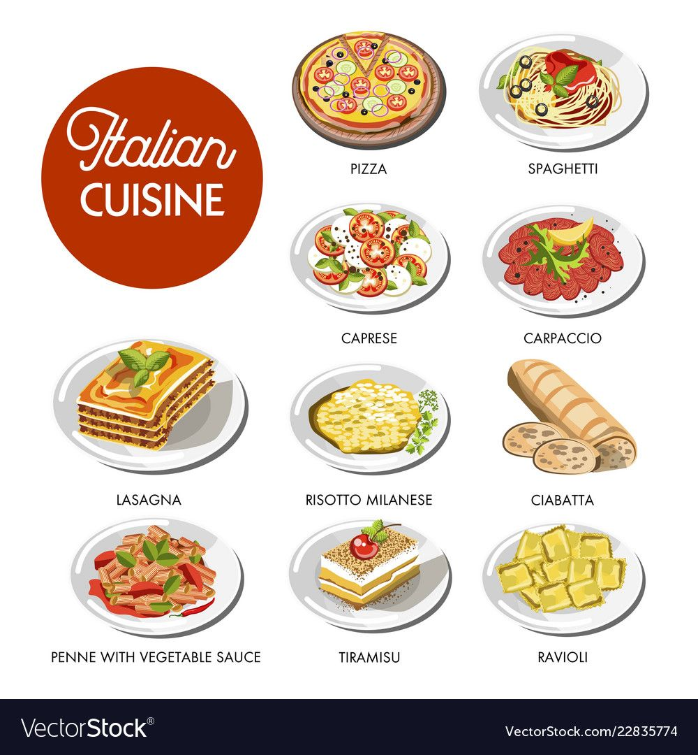
Why Italian Cuisine in Brooklyn
It is very famous worldwide
Brooklyn is a crowded place with 2.6 million residents

Slide 3


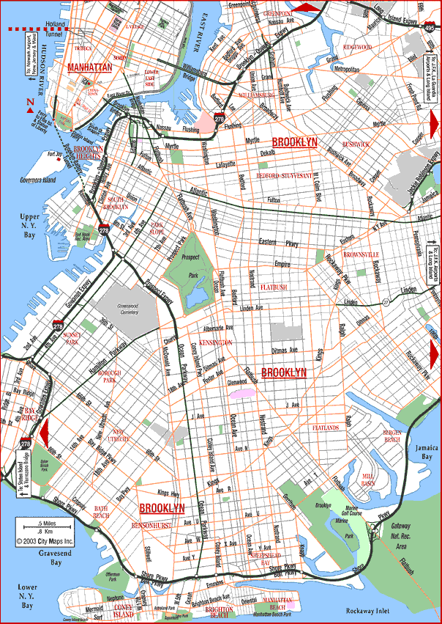
Business Problem
What is the best location to start a business in Italian cuisine in Brooklyn?

Slide 4
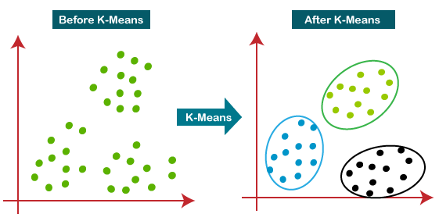
Methodology
We use k-means clustering to obtain the best location for opening a business in Italian cuisine

Slide 5
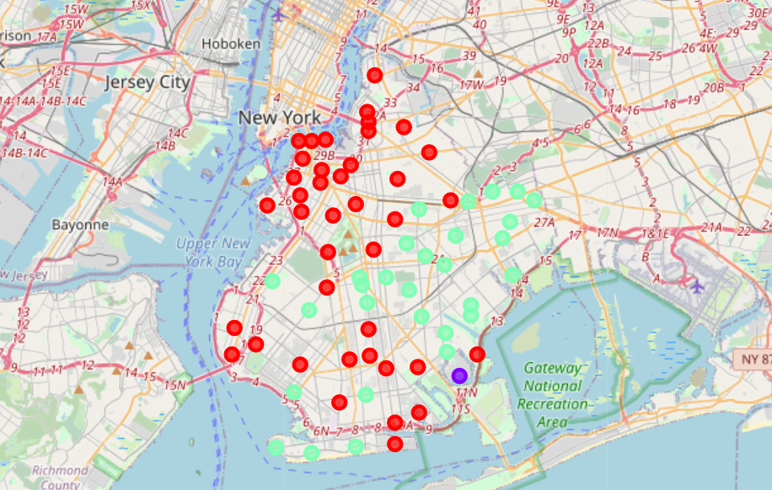
Result
Red = Cluster 1
Purple = Cluster 2
Green = Cluster 3

Slide 6
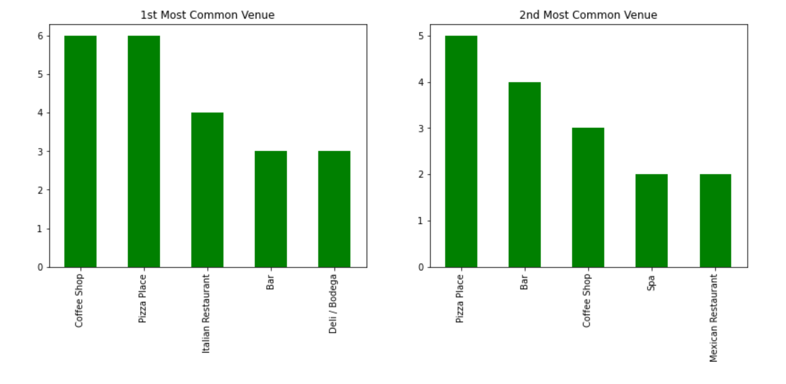
Best Location
Best location is located in cluster 1, with the most frequency for Italian cuisine.

Slide 7
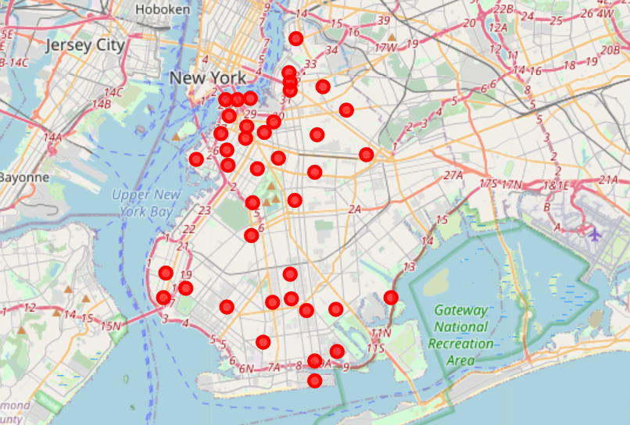
Best location on map

